Slide 1

Houdini 15
Robert Rajakone
Roger Müller
Florian Bruggisser

Slide 2
Info
Releasedate
OCTOBER 15, 2015
Tools
Modeling tools
Rendering tools
Animation tools
VFX tools

Slide 3
Modeling Rendering
Working in the viewport
Procedural modeling
Edge sliding
PolyBridge
PolyExpand
Reto(pology) tools
Materials
Shader FX 2,0
RenderMan 20 Support

Slide 4
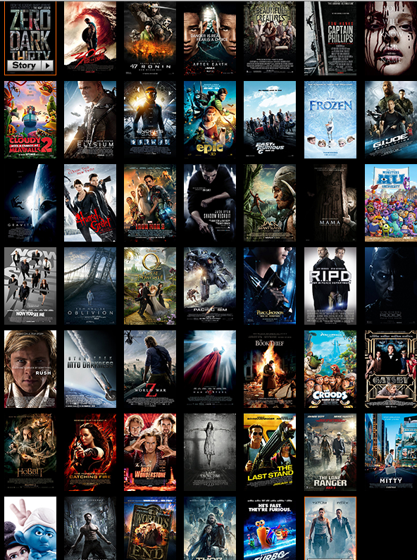
Animation & VFX

Slide 5
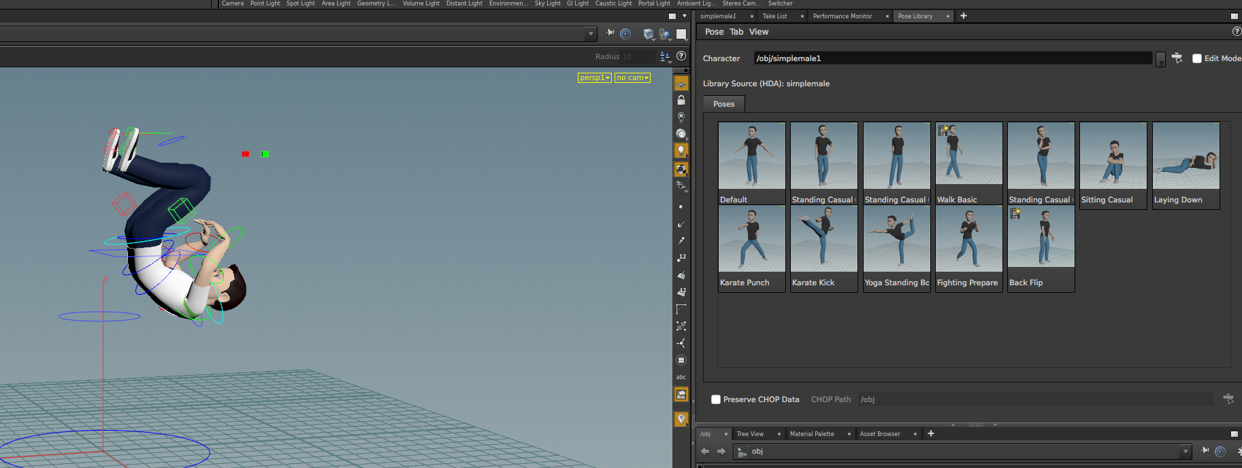
Pose Library

Slide 6
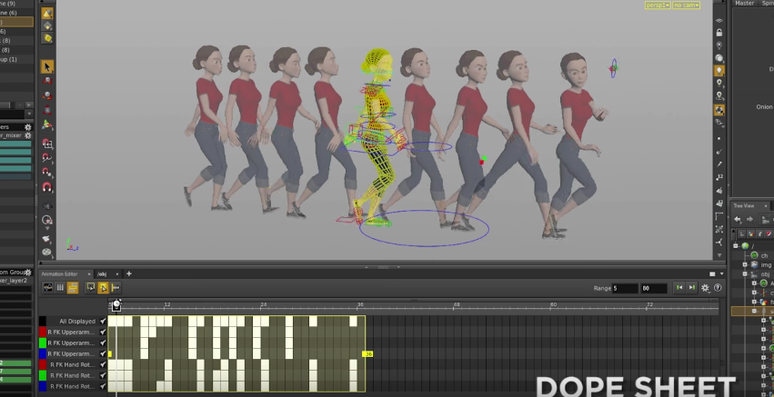
Onion Skinning

Slide 7
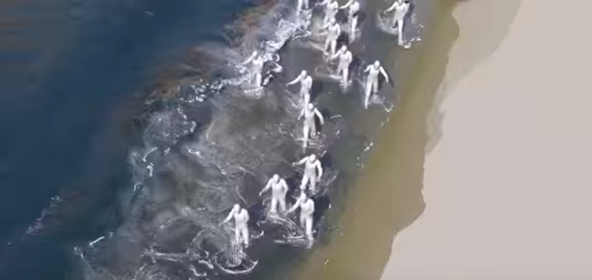
Crowd Ragdolls

Slide 8
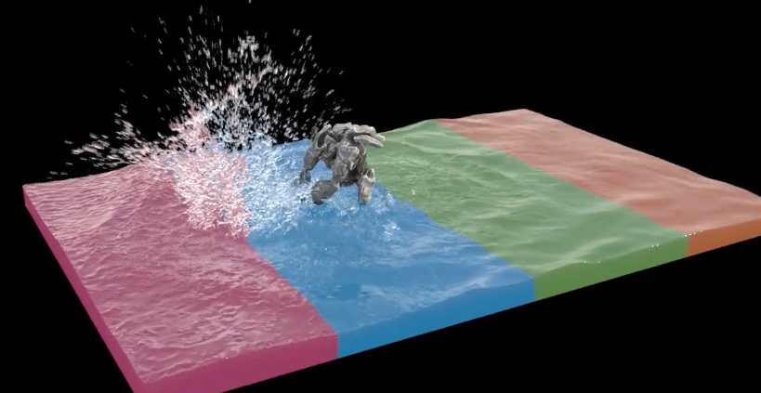
Distributed Simulations

Slide 9

Video
https://youtu.be/ok3-NEDNeTg?t=101
https://www.youtube.com/watch?v=9Zyqp7Yme6g
Notes:
https://youtu.be/ok3-NEDNeTg?t=101
https://www.youtube.com/watch?v=9Zyqp7Yme6g

Slide 10



Houdini for Games
Houdini Engine 2,0
Houdini Engine for Unity 4,6 and above
Houdini Engine for Maya
Houdini Engine for Unreal Engine 4,8 / 4,9

Slide 11
Questions?

